Slide 1
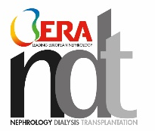
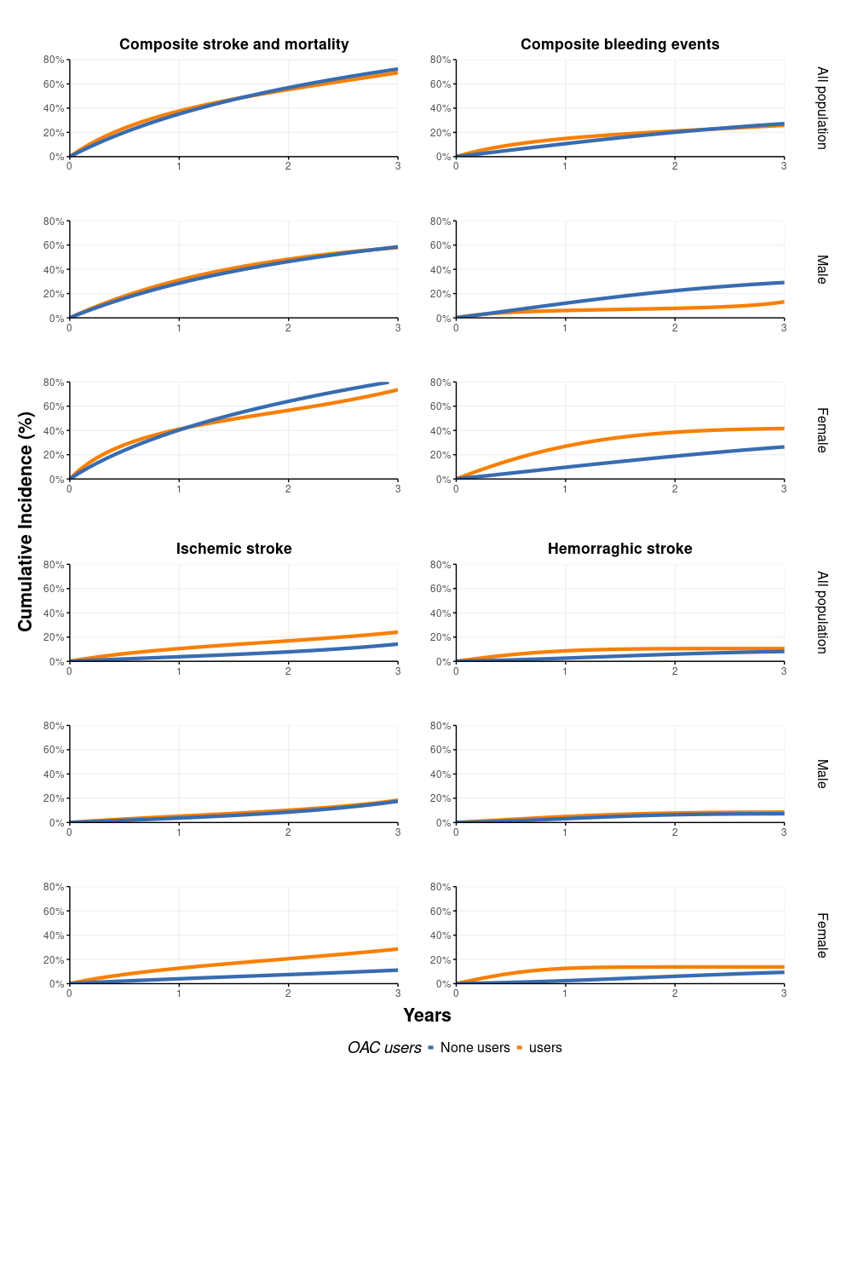
Effectiveness and safety of oral anticoagulant use in dialysis patients with atrial fibrillation or atrial flutter in Hong Kong - a sequential target trial emulation
Aims
Results
The focus of this study is to evaluate the effectiveness and safety of oral anticoagulant (OAC) initiation in the dialysis patient population in Hong Kong.
Table. Estimated 3-year risks of stroke in emulated target trials in kidney failure on peritoneal dialysis, HK CDARS
 | Risk % (95% CI) |  | 3-year Risk difference (%)
 | non-initiators | OAC initiators
Composite stroke outcome (death and stroke) | 0.72 (0.66, 0.80) | 0.69 (0.55, 0.83) | -0.03 (-0.18, 0.11)
Ischemic stroke | 0.14 (0.12, 0.16) | 0.24 (0.11, 0.40) | 0.10 (-0.03, 0.26)
Haemorraghic stroke | 0.08 (0.06, 0.10) | 0.11 (0.04, 0.18) | 0.02 (-0.04, 0.10)
All-cause mortality | 0.71 (0.69, 0.72) | 0.65 (0.54, 0.77) | -0.05 (-0.16, 0.06)
Figure. Estimated risk of composite outcome, all-bleeding events, ischemic stroke and haemorrhagic stroke incidence over 3 years, by oral anticoagulant drug use or not, on peritoneal dialysis patients, HK CDARS data 2007- 2022
Methods
N = 8,230 dialysis patients with
incident atrial fibrillation or atrial flutter
OAC users
non-users
Sequential trials with target trial emulation
Propensity score 1:10 matching
Cumulative incidence rate of stroke, bleeding, or all-cause mortality
Subgroup by age and sex
Cheng, FWT. et al.
NDT (2025)
@NDTSocial
The initiation of oral anticoagulants was not associated with a significant reduction in the risk of stroke, mortality, or major bleeding.
The benefits of OACs in this high-risk population remain uncertain.

